Slide 1


Investigation of Vulnerabilities in Open RAN Implementations
Research Project – WS 22/23
Arnova Abdullah
Weekly meeting-09 (15.12.2022)

Slide 2
Previous Weeks Meeting Details
Week 1 Meeting (19.10.2022)
Basics about Radio Access Network (History, parts of RAN for 1G, 2G, 3G, 4G)
Basics about Open RAN (Distribution unit, central unit, user plane, control plane, interfaces, front haul, mid haul, backhaul)
Open RAN risk analysis (Stakeholders of attackers-User, external attacker, cloud operator**, RAN operator**)
Week 2 Meeting (26.10.2022)
Installation of Kali Linux and Metasploitable
Atomic Red Team GitHub repository download
Research other open-source attack tools
Week 3 Meeting (02.11.2022)
Penetration testing using Kali Linux
Try Atomic tests by invoke-atomic
Get used to commands used for running a test
Research details about one of the attack tools - Infection Monkey
Read research papers on the risk of 5G open RAN
Week 4 Meeting (09.11.2022)
Finding the most relatable attacks from the MITRE ATTACK list (On going)
CyberOps course ongoing
Research paper by MOU

Slide 3

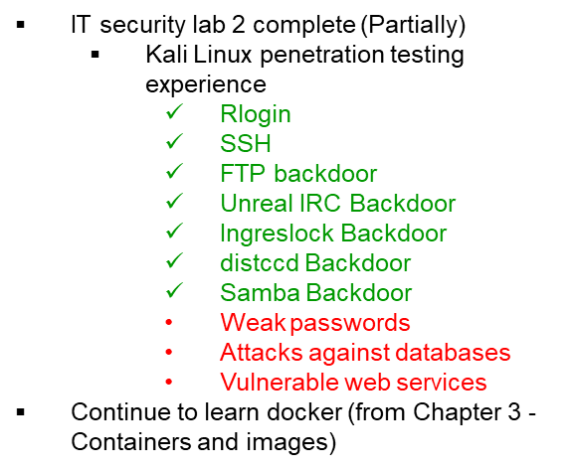

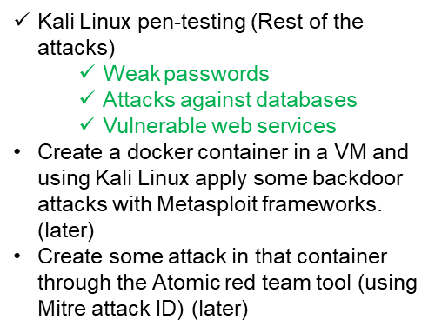
Previous Weeks Meeting Details
Week 5 Meeting (17.11.2022)
Install Infection monkey (Need AWS subscription, don’t continue anymore!!)
Start learning Docker container
https://developer.cisco.com/learning/tracks/containers/
https://learning.oreilly.com/videos/docker-fundamentals-for/9781803237428/9781803237428-video1_1/
Week 8 Meeting (08.12.2022)
Make a comparison between Kali Linux tools and Atomic Red Team
Select one to use at the end of the project

Slide 4
Week 9 (Until 15.12.2022)
Create a list for Docker, and Kubernetes attack:
How to attack the docker container?
What are the tools? (If required any)
What are the known vulnerabilities? (CVE, MITRE)
Create a list for Ubuntu:
How to attack Ubuntu?
What are the tools? (If required any)
What are the known vulnerabilities? (CVE, MITRE)
Try to install Atomic red team in Kali Linux

Slide 5
Research
CVE List:
https://www.cvedetails.com/vulnerability-list/vendor_id-4781/product_id-20550/opginf-1/Canonical-Ubuntu-Linux.html
https://cve.mitre.org/find/search_tips.html
I didn’t find anything for open RAN. But there are some rules for searching with keywords. I will research and find this.

Slide 6
Next Steps (Week 10)
Create a list for Docker, and Kubernetes attack:
How to attack the docker container?
What are the tools? (If required any)
What are the known vulnerabilities? (CVE, MITRE)
Create a list for Ubuntu:
How to attack Ubuntu?
What are the tools? (If required any)
What are the known vulnerabilities? (CVE, MITRE)
Try to install Atomic red team in Kali Linux

